Slide 1
Chapter 4
Basic SQL

Slide 2
Chapter 4 Outline
SQL Data Definition and Data Types
Specifying Constraints in SQL
Basic Retrieval Queries in SQL
INSERT, DELETE, and UPDATE Statements in SQL
Additional Features of SQL

Slide 3
Basic SQL
SQL language
Considered one of the major reasons for the commercial success of relational databases
SQL
Structured Query Language
Statements for data definitions, queries, and updates (both DDL and DML)
Core specification
Plus specialized extensions

Slide 4
SQL Data Definition and Data Types
Terminology:
Table, row, and column used for relational model terms relation, tuple, and attribute
CREATE statement
Main SQL command for data definition

Slide 5
Schema and Catalog Concepts in SQL
SQL schema
Identified by a schema name
Includes an authorization identifier and descriptors for each element
Schema elements include
Tables, constraints, views, domains, and other constructs
Each statement in SQL ends with a semicolon

Slide 6
Schema and Catalog Concepts in SQL (cont’d.)
CREATE SCHEMA statement
CREATE SCHEMA COMPANY AUTHORIZATION ‘Jsmith’;
Catalog
Named collection of schemas in an SQL environment
SQL environment
Installation of an SQL-compliant RDBMS on a computer system

Slide 7
The CREATE TABLE Command in SQL
Specify a new relation
Provide name
Specify attributes and initial constraints
Can optionally specify schema:
CREATE TABLE COMPANY.EMPLOYEE ...
or
CREATE TABLE EMPLOYEE ...

Slide 8
The CREATE TABLE Command in SQL (cont’d.)
Base tables (base relations)
Relation and its tuples are actually created and stored as a file by the DBMS
Virtual relations
Created through the CREATE VIEW statement

Slide 9
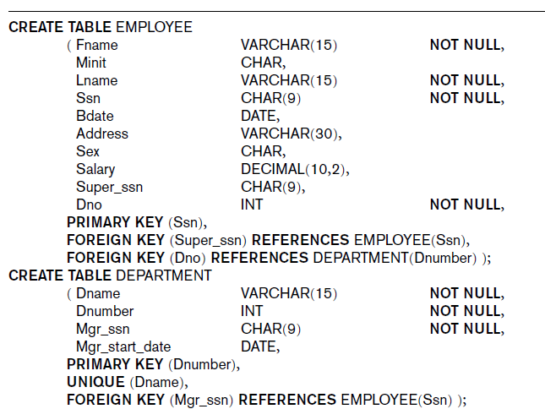
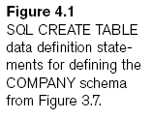

Slide 10
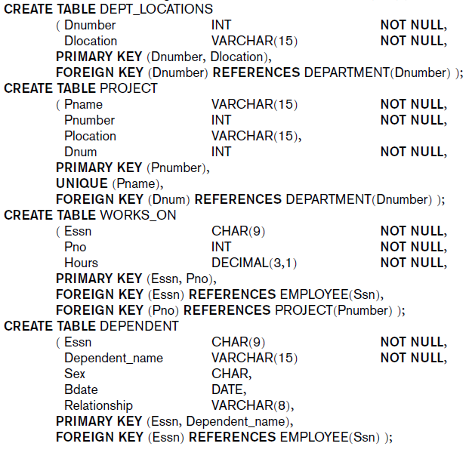

Slide 11
The CREATE TABLE Command in SQL (cont’d.)
Some foreign keys may cause errors
Specified either via:
Circular references
Or because they refer to a table that has not yet been created

Slide 12
Attribute Data Types and Domains in SQL
Basic data types
Numeric data types
Integer numbers: INTEGER, INT, and SMALLINT
Floating-point (real) numbers: FLOAT or REAL, and DOUBLE PRECISION
Character-string data types
Fixed length: CHAR(n), CHARACTER(n)
Varying length: VARCHAR(n), CHAR VARYING(n), CHARACTER VARYING(n)

Slide 13
Attribute Data Types and Domains in SQL (cont’d.)
Bit-string data types
Fixed length: BIT(n)
Varying length: BIT VARYING(n)
Boolean data type
Values of TRUE or FALSE or NULL
DATE data type
Ten positions
Components are YEAR, MONTH, and DAY in the form YYYY-MM-DD

Slide 14
Attribute Data Types and Domains in SQL (cont’d.)
Additional data types
Timestamp data type (TIMESTAMP)
Includes the DATE and TIME fields
Plus a minimum of six positions for decimal fractions of seconds
Optional WITH TIME ZONE qualifier
INTERVAL data type
Specifies a relative value that can be used to increment or decrement an absolute value of a date, time, or timestamp

Slide 15
Attribute Data Types and Domains in SQL (cont’d.)
Domain
Name used with the attribute specification
Makes it easier to change the data type for a domain that is used by numerous attributes
Improves schema readability
Example:
CREATE DOMAIN SSN_TYPE AS CHAR(9);

Slide 16
Specifying Constraints in SQL
Basic constraints:
Key and referential integrity constraints
Restrictions on attribute domains and NULLs
Constraints on individual tuples within a relation

Slide 17
Specifying Attribute Constraints and Attribute Defaults
NOT NULL
NULL is not permitted for a particular attribute
Default value
DEFAULT <value>
CHECK clause
Dnumber INT NOT NULL CHECK (Dnumber > 0 AND Dnumber < 21);

Slide 18
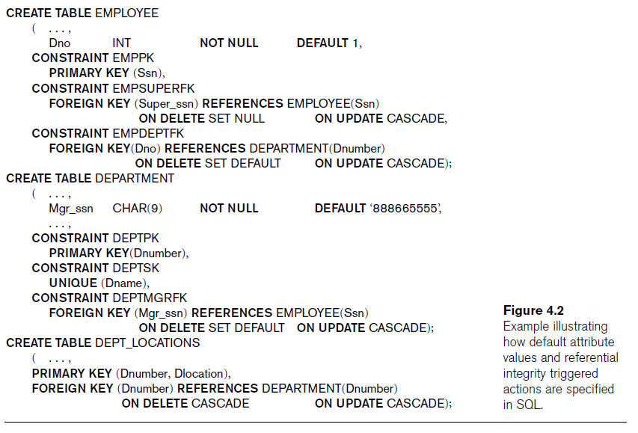

Slide 19
Specifying Key and Referential Integrity Constraints
PRIMARY KEY clause
Specifies one or more attributes that make up the primary key of a relation
Dnumber INT PRIMARY KEY;
UNIQUE clause
Specifies alternate (secondary) keys
Dname VARCHAR(15) UNIQUE;

Slide 20
Specifying Key and Referential Integrity Constraints (cont’d.)
FOREIGN KEY clause
Default operation: reject update on violation
Attach referential triggered action clause
Options include SET NULL, CASCADE, and SET DEFAULT
Action taken by the DBMS for SET NULL or SET DEFAULT is the same for both ON DELETE and ON UPDATE
CASCADE option suitable for “relationship” relations

Slide 21
Giving Names to Constraints
Keyword CONSTRAINT
Name a constraint
Useful for later altering

Slide 22
Specifying Constraints on Tuples Using CHECK
CHECK clauses at the end of a CREATE TABLE statement
Apply to each tuple individually
CHECK (Dept_create_date <= Mgr_start_date);

Slide 23
Basic Retrieval Queries in SQL
SELECT statement
One basic statement for retrieving information from a database
SQL allows a table to have two or more tuples that are identical in all their attribute values
Unlike relational model
Multiset or bag behavior

Slide 24
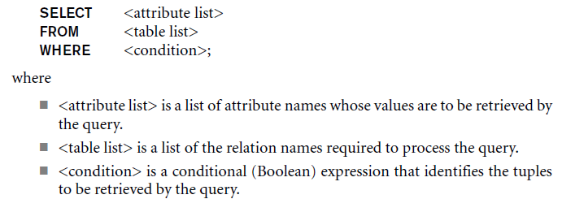
The SELECT-FROM-WHERE Structure of Basic SQL Queries
Basic form of the SELECT statement:

Slide 25
The SELECT-FROM-WHERE Structure of Basic SQL Queries (cont’d.)
Logical comparison operators
=, <, <=, >, >=, and <>
Projection attributes
Attributes whose values are to be retrieved
Selection condition
Boolean condition that must be true for any retrieved tuple

Slide 26
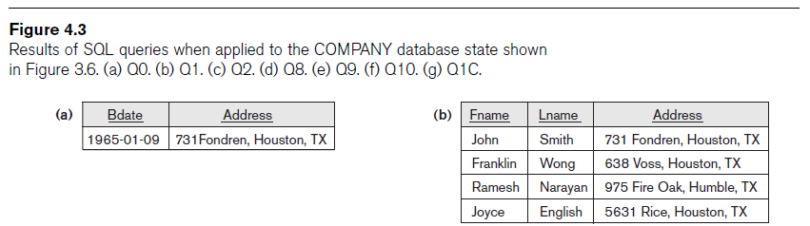
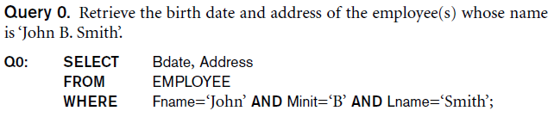
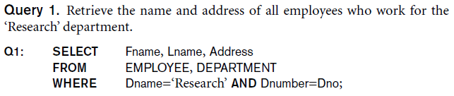

Slide 27

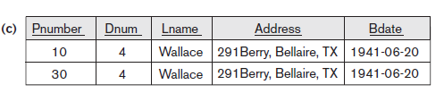
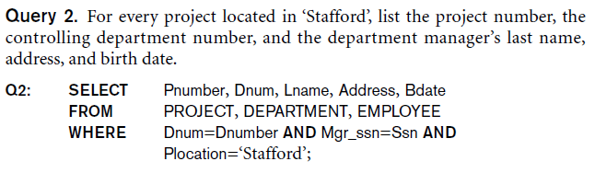

Slide 28

Ambiguous Attribute Names
Same name can be used for two (or more) attributes
As long as the attributes are in different relations
Must qualify the attribute name with the relation name to prevent ambiguity

Slide 29

Aliasing, Renaming, and Tuple Variables
Aliases or tuple variables
Declare alternative relation names E and S
EMPLOYEE AS E(Fn, Mi, Ln, Ssn, Bd, Addr, Sex, Sal, Sssn, Dno)

Slide 30
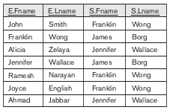
Aliasing, Renaming, and Tuple Variables

Slide 31
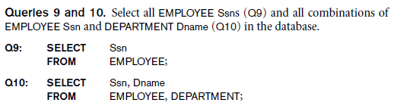
Unspecified WHERE Clause and Use of the Asterisk
Missing WHERE clause
Indicates no condition on tuple selection
CROSS PRODUCT
All possible tuple combinations

Slide 32
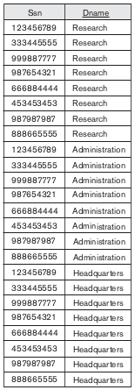

Unspecified WHERE Clause and Use of the Asterisk
Q9
Q10

Slide 33
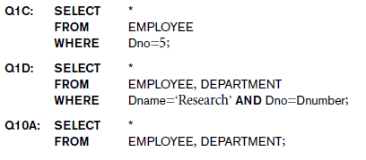
Unspecified WHERE Clause and Use of the Asterisk (cont’d.)
Specify an asterisk (*)
Retrieve all the attribute values of the selected tuples

Slide 34
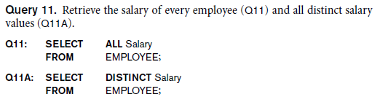
Tables as Sets in SQL
SQL does not automatically eliminate duplicate tuples in query results
Use the keyword DISTINCT in the SELECT clause
Only distinct tuples should remain in the result

Slide 35
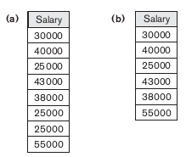
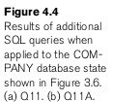
Tables as Sets in SQL

Slide 36
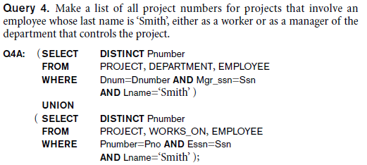
Tables as Sets in SQL (cont’d.)
Set operations
UNION, EXCEPT (difference), INTERSECT
Corresponding multiset operations: UNION ALL, EXCEPT ALL, INTERSECT ALL)

Slide 37
Substring Pattern Matching and Arithmetic Operators
LIKE comparison operator
Used for string pattern matching
% replaces an arbitrary number of zero or more characters
underscore (_) replaces a single character
Standard arithmetic operators:
Addition (+), subtraction (–), multiplication (*), and division (/)
BETWEEN comparison operator

Slide 38


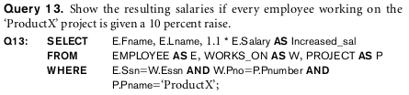

Substring Pattern Matching and Arithmetic Operators

Slide 39
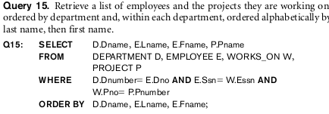
Ordering of Query Results
Use ORDER BY clause
Keyword DESC to see result in a descending order of values
Keyword ASC to specify ascending order explicitly
ORDER BY D.Dname DESC, E.Lname ASC, E.Fname ASC

Slide 40
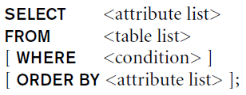
Discussion and Summary of Basic SQL Retrieval Queries

Slide 41
INSERT, DELETE, and UPDATE Statements in SQL
Three commands used to modify the database:
INSERT, DELETE, and UPDATE

Slide 42


The INSERT Command
Specify the relation name and a list of values for the tuple

Slide 43

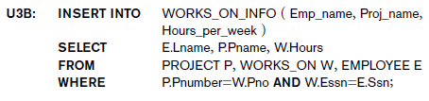
The INSERT Command

Slide 44
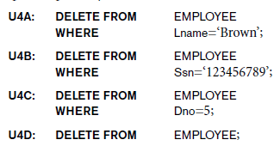
The DELETE Command
Removes tuples from a relation
Includes a WHERE clause to select the tuples to be deleted

Slide 45


The UPDATE Command
Modify attribute values of one or more selected tuples
Additional SET clause in the UPDATE command
Specifies attributes to be modified and new values

Slide 46
Additional Features of SQL
Techniques for specifying complex retrieval queries
Writing programs in various programming languages that include SQL statements
Set of commands for specifying physical database design parameters, file structures for relations, and access paths
Transaction control commands

Slide 47
Additional Features of SQL (cont’d.)
Specifying the granting and revoking of privileges to users
Constructs for creating triggers
Enhanced relational systems known as object-relational
New technologies such as XML and OLAP

Slide 48
Summary
SQL
Comprehensive language
Data definition, queries, updates, constraint specification, and view definition
Covered in Chapter 4:
Data definition commands for creating tables
Commands for constraint specification
Simple retrieval queries
Database update commands

